Slide 1
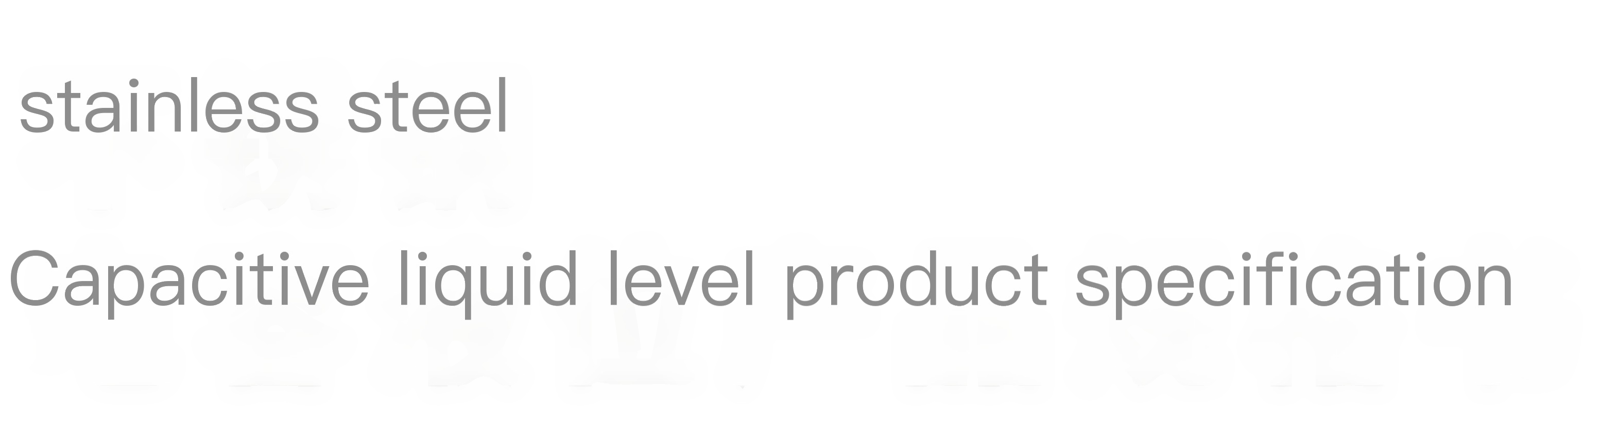
DRYEWEI
GANXIE
Version V1.12
Remote monitoring of vehicle tank body, oil consumption, and liquid level
BEIDOUYUNWEI
Precautions
01
Default measurement is diesel. Please inform us in advance if you want to measure its liquid
，
02 Applicable to fuel tank bodies made of various metal and plastic materials
03
The cutting needs to be customized according to the height of the tank body
04
The maximum analog value allowed by the protocol is 65535, which corresponds to the length of the pole. Please confirm the serial port in advance
，
RS485/RS232
.

Slide 2


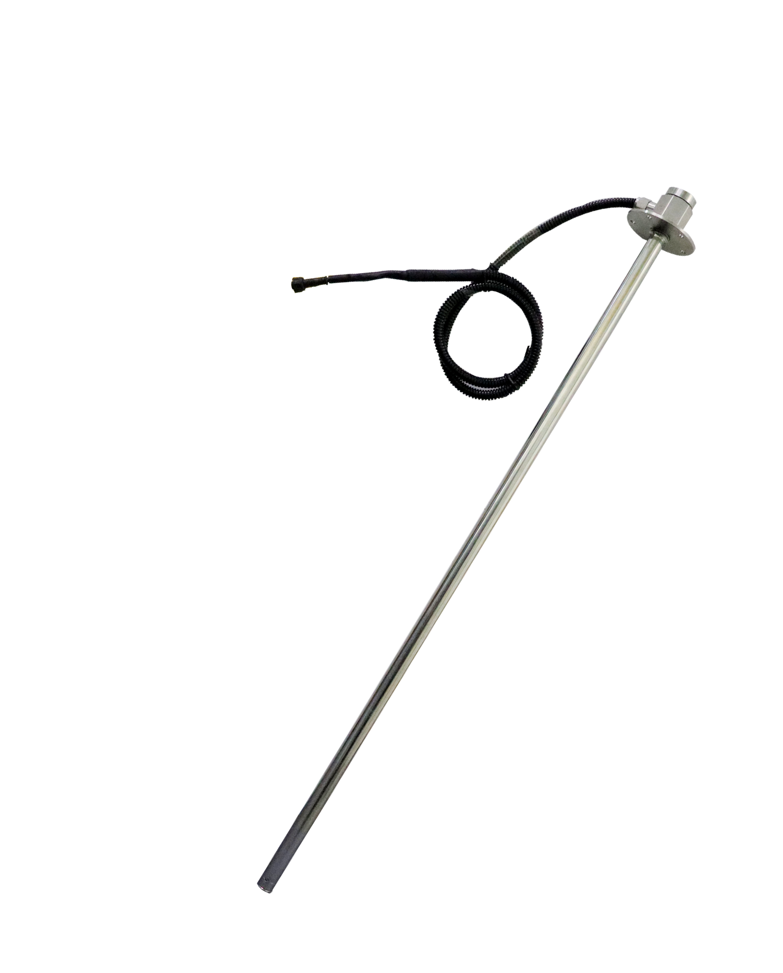

Product Introduction
The capacitive sensor is made of 302/304 material. When detecting small changes in capacitance (usually in pf) caused by liquid level changes, a dedicated capacitive detection chip is used to measure these changes
Signal processing, segmented multi-acquisition, capable of outputting multiple results
A specific signal communication protocol, this dedicated
Capacitive detection chips, with their built-in dual-core MCU processing, can achieve many special control functions, and even more integrated and intelligent liquid level detection functions. For applications such as truck fuel tank levels and lubricant tank levels, they can reliably detect changes in liquid levels after power loss. Capacitive liquid level detection is currently the most advantageous detection method among liquid level transmitters.
Features
It is waterproof, lightweight, and has an aesthetically pleasing structural design, making installation simple and convenient. It comes with built-in fixing brackets and anti-slip washers;
Easy to install, securely fixed, and convenient to disassemble;
Powered by DC 5V, it is compatible with various positioning hosts and vehicles;
RS232 / RS485 / digital interface, universal output protocol; super strong signal strength, built-in anti-interference structure and circuit to adapt to fuel tanks and cans of different thicknesses and materials;
Intelligent algorithm filtering, high stability output;
Built-in high-precision calculation and filtering algorithm formula;
1mm-level measurement accuracy, with configurable stable filtering output;
Market conventional output protocol; supports 99% of host devices in the market;
Remote calibration and detection can be performed based on the different media of the measured liquid;
Scope of Application
Remote fuel consumption monitoring for trucks, oil consumption detection for construction machinery, and tank level detection
Oil tank inspection machinery for passenger and dangerous goods vehicles, as well as oil quantity monitoring
1/9

Slide 3

Fuel consumption monitoring for environmental sanitation vehicles, tank level monitoring for transport vehicles, fuel consumption monitoring for marine fuel tanks, and liquid level measurement for storage tanks
Air quality
Fuel tank fluid ⾯
Basic Parameters
parameter
Input voltage
Operating current, measurement range, resolution, measurement accuracy, measured liquid, communication interface, communication rate, line sequence definition
Specification Description
DC5v
unit
V
MA mm mm degree
Remarks
Operating temperature: -30 to 75 degrees
customizable
Filtering can be set
≦10ma
200mm-2250mm
1mm 0.1
Diesel, gasoline, light oil, low-medium oil products, water, and other flowing liquids
RS232/RS485
9600
Chuankou
bit/S
customizable
Baud rate adjustable
Black - Ground; Red - Positive; Green - TX/B; Yellow - RX/A
2/9

Slide 4

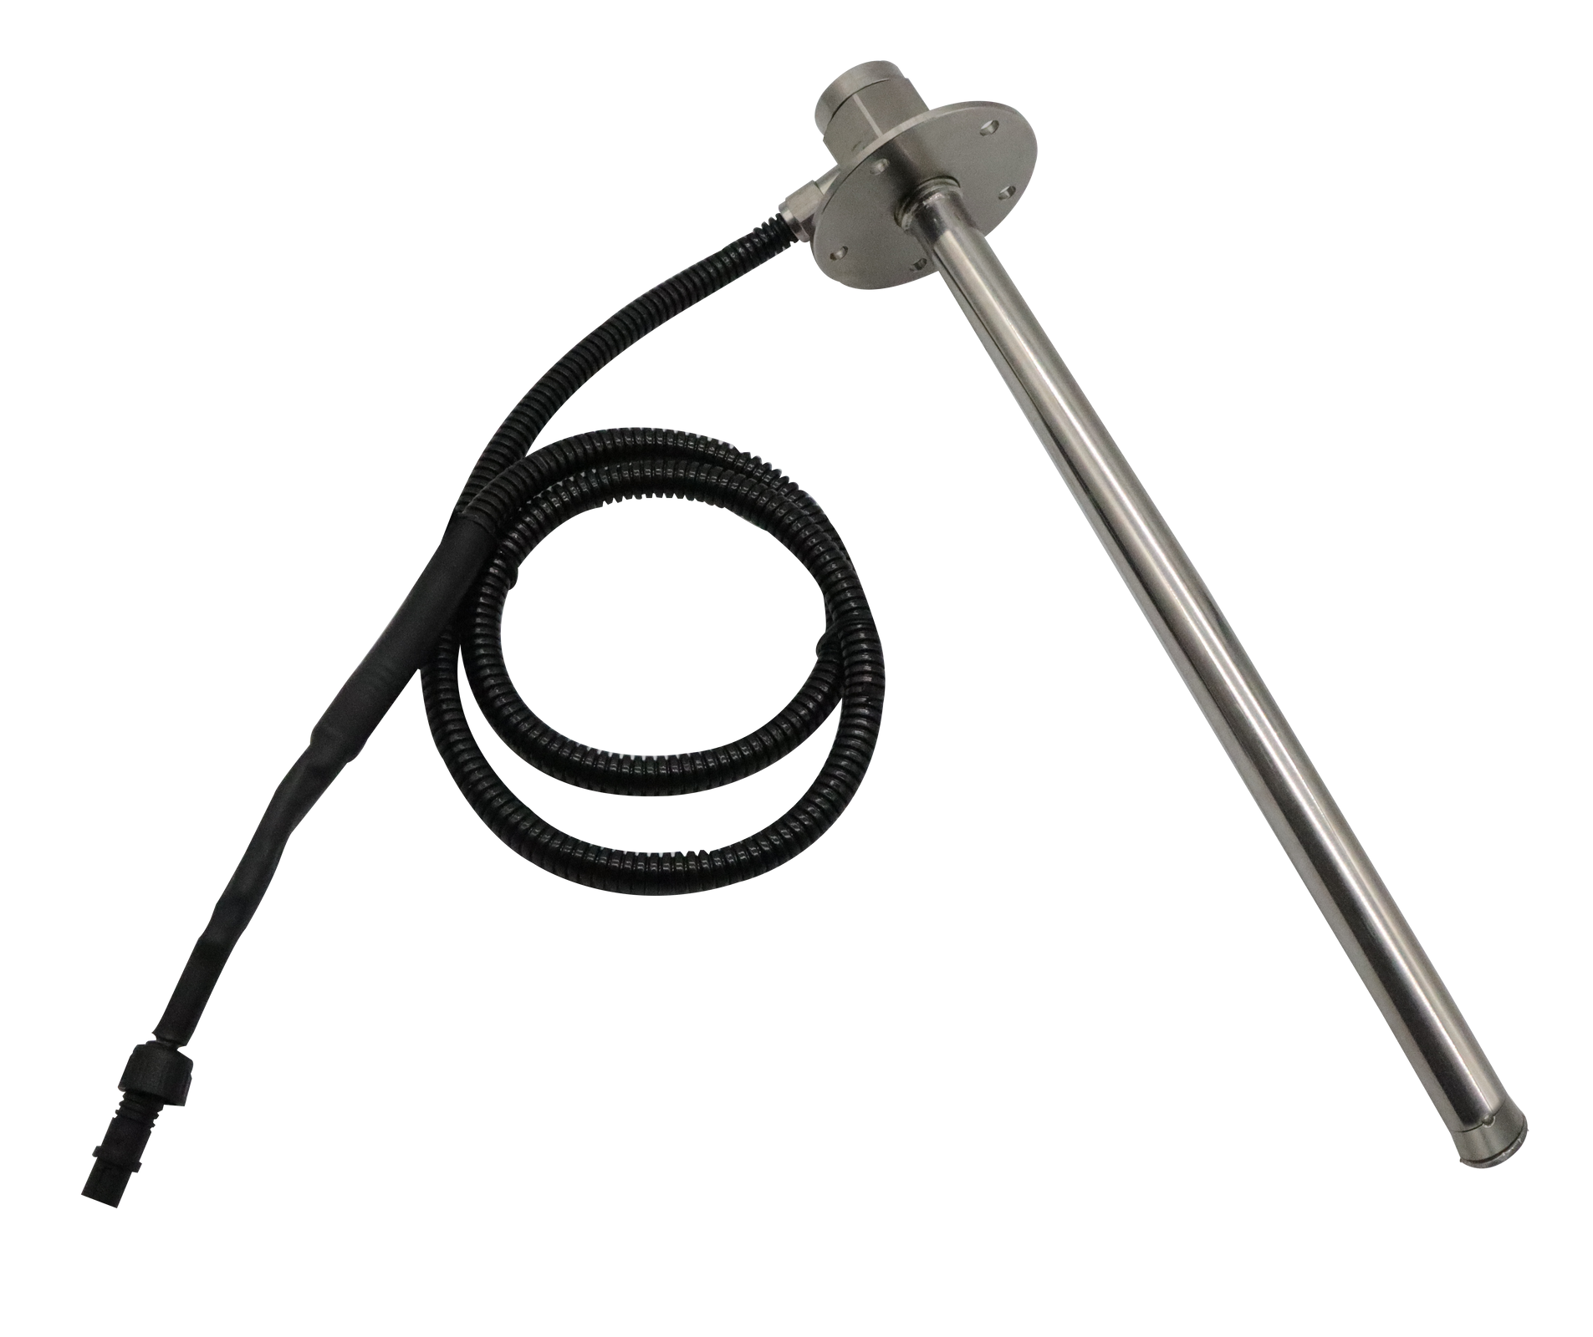
Note:
(1) At room temperature and 1 standard atmosphere, the default measured liquid is 0# diesel. The measurement range can be modified, and the sensor length needs to be customized according to the fuel tank. Please specify the height. The measurement range can be modified and different types of liquids can be detected for corresponding shipments;
(2) The pole has a wall thickness of 1mm and is constructed of stainless steel. Depending on the liquid being measured, please take precautions in advance
Inform and prepare different types of stainless steel materials for production.
(3) Long-term inventory for RS232 and RS485 interfaces, with customizable dimensions and voltage
Please make a reservation in advance for analog current output. It is recommended that the transmission distance for RS232 be less than
10m. For communication distances exceeding 10m, please choose RS485.
Product Structure Diagram
lid
Mainboard storage
flange
Sewing structure
Install the gasket
Outer tube wall
Sensor core
Corrugated tubing 3/7 MI
Lower shrink tube sealing
3/9

Slide 5
2/10
Default protocol (Universal protocol for fuel rod and fuel quantity)
(1) Set the liquid level sensor ID (multiple sensors, using 485/232 communication ID by default)
Think 01)
The command sent from the terminal or computer to the liquid level meter is ASCII: $!ID0133
The ID is the command 01, which is the ID value
hexadecimal
:24214944303133330D0A
Reply from liquid level meter:
ASCII:*SID01OKOKOK39 indicates success.
*SID01NONONO42 indicates failure.
01 represents the set ID value, OKOKOK indicates successful setting, and ONONON indicates failed setting.
Hexadecimal:
2A53494430314F4B4F4B4F
4B33390D0A
2A53494430314E4F4E4F4E4F3432
0D0A
(2) Read liquid level filtered digital value (recommended as a GPS device read command): Command sent from the terminal or computer to the oil level gauge:
ASCII:$!RY0151
Hexadecimal: 24215259303135310D0A
Oil level gauge reply:
ASCII:*CFV0100FA32B6
Protocol explanation: *CFV is the protocol output; 01 is the return address bit; 00FA32 is the current AD value, where 00 is padded with zeros if less than 6 bytes, and FA32 represents the current oil level
The hexadecimal representation of the ASCII value of AD, which indicates that the current oil level value is 0xFA32;
B6 is for parity check.
Liquid level conversion: *CFV0100FA32B6: 00FA32 (hexadecimal) =
64050 (decimal)
->64050/65535*1000≈977.3mm
Note: This AD value corresponds to the change of oil level from 0% to 100%
AD values ranging from 000000 to 00FFFF
Hexadecimal: 42360D
2A4346563031303046413332
0A
4/9

Slide 6

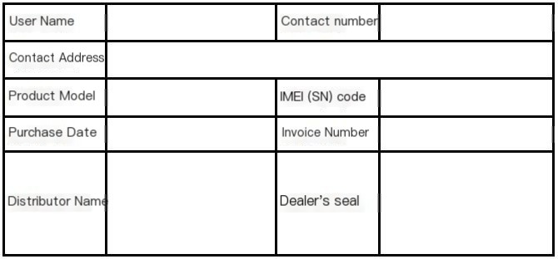
Packing List
serial number
1
2
3
4
name
sensor
shim
extension cable flange
quantity
1
1
1
1
unit
a
a
Article one
purpose
Prevent oil leakage within a range of 3 meters or 6 meters
Remarks
Remember to apply sealant
The default waterproof head can be terminated
Installation accessories
1
4
6
7
8
electric drill
Install silicone 25-hole opener, wiping cloth, and cable tie
1
1
1
1
5
a
Support one
"Tiao Ge"
bring your own
"Self-prepared"
It is recommended to bring your own suggestions
When installing the sensor
seal
opening
Clean the fixed cables of the fuel tank
Liquid level reading tool
1
display board
1
a
Test installation and reading
liquid level
optional
Complete set of products: gross weight around 1Kg, packaging size: 75cm x 12cm x H10cm (triangle)
After-sales warranty card
5/

Slide 7

Manufacturer:
Company headquarters:
production base
Company website:
Certificate of Conformity
Contact Information
The product has passed inspection and is approved for shipment
Product model: _________
Inspector: __________ Date of Manufacture: _________
Installation method
project
Prepare the product
Prepare tools
Fire extinguisher at installation site
Instructions
For details of the host sensor, please refer to the packaging specification
Electric drill, hole saw, steel ruler, sealant, cable tie, calibration tool, computer, etc
The vehicle needs to be parked in a stable place in case of an accident
Remarks
All inspections are complete
"Be sure to bring it according to the situation."
Gradually drilling holes on flat ground
Note: Ensure the vehicle is stopped and the engine is turned off. Inspect the tools before installation. If possible, test the device sensors upon receipt
6/9

Slide 8


Installation Process
Received equipment for testing
The vehicle is parked level
Measure the position of the fuel tank
Searching for installation location
Slowly open the hole
Fixed sensor
Conform to inspection data
fixed line
Installation completed
Horizontal angle: The vehicle is parked level, with the fuel tank's horizontal inclination angle being less than 5 degrees
Oil level height: It's better to have oil level inside for installation
rear of the car
Recommended installation
front of the vehicle
yellow zone
Remember to keep the area clear and avoid obstacles
Avoid areas: oil pump, oil float
Obstacles such as sub-units, heating tubes, oil tank partitions, and oil rods
The tank body is horizontal, and the sensor is installed horizontally
correct
Installation area: The installation point should be as close as possible to the middle of the bottom of the fuel tank
The surface of the tank is uneven
error
Tank body or sensor tilting tank body arc, sensor horizontal tank body arc, sensor tilting
error
Installation surface: It should be flat and level. The installation distance should be just enough to reach the bottom of the fuel tank. After installation, no gaps should remain and it must be sealed properly.
correct
error
7/9

Slide 9
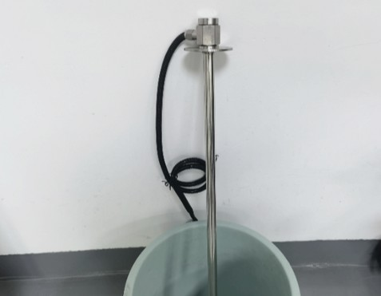
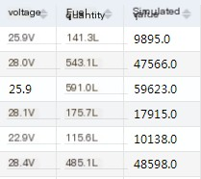
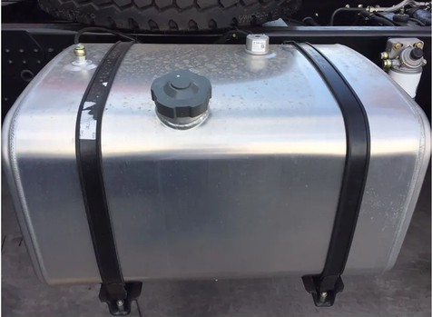
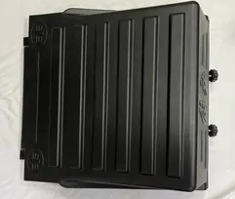
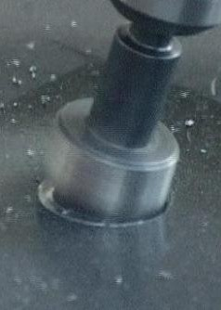
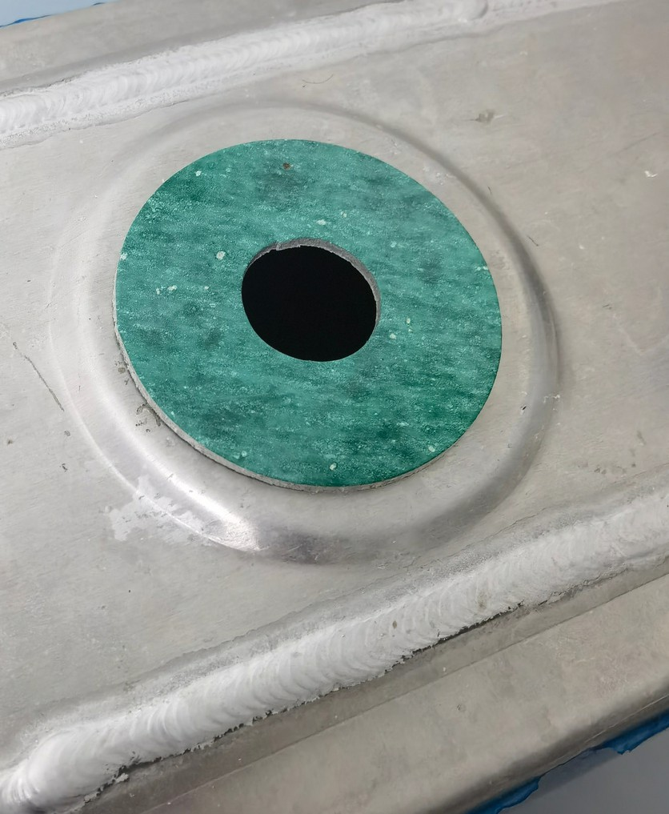
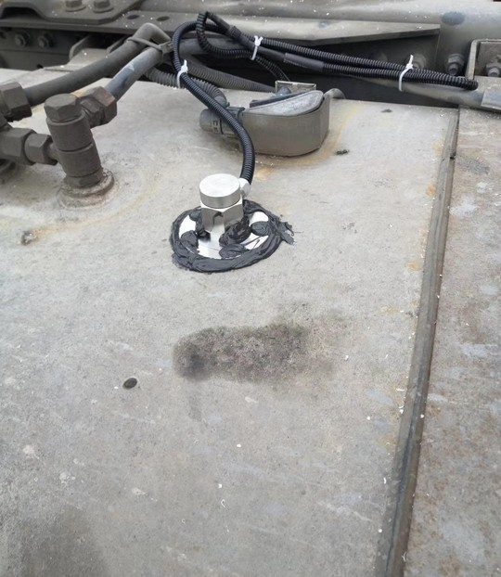
Installation example
After receiving the product, power on the device first
Plug in to connect to the host or read the data from the controller
Insert the rod into a little water or diesel to check if the platform has analog quantity
Measure the middle position of the fuel tank, and simultaneously measure its length and width, in preparation for calibrating the fuel tank capacity later
Measure the height of the fuel tank, determine the location for installing the main unit, and confirm that the battery box is made of iron
If it's to be installed outside, the main unit should be wrapped in a plastic bag for waterproofing
Measure the middle position of the fuel tank, and simultaneously measure its length and width, in preparation for calibrating the fuel tank capacity later
Check the installation position of the fuel tank. Observe the upper part of the fuel tank to find the center
"The interior should be flat and clear of obstacles such as partitions, oil pumps, and oil floaters."
The diaphragm can be identified by listening to the sound produced by knocking, or by drilling a 4mm small hole and probing it with a thin steel wire, or by observing through the oil tank opening
Remember to drill slowly, blow off the debris generated at any time, and make sure it doesn't fall into the oil tank. When it's almost done, stop and use pliers to pull it down
When applying sealing silicone, choose varieties that are oil-resistant, corrosion-resistant, and waterproof
Install the gasket, tighten the sensor with self-tapping screws, and then apply a layer of sealant
Connect to the host, check the uploaded analog data, ensure it roughly matches the remaining fuel quantity data, and confirm the fixed line installation is complete

Slide 10

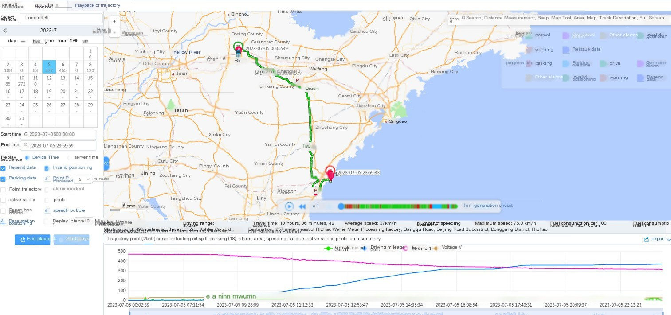
Platform Features
Record daily mileage, fuel consumption, driving trajectory, monitor changes in fuel tank level, automatically calculate startup working hours, tally monthly working hours, and also monitor idle time, idle fuel consumption, and idle fuel consumption. Record vehicle overspeed, fatigue driving, and other abnormal behaviors
Accurately record refueling times, generate graphical and textual reports, and compile statistics on monthly and daily fuel consumption and usage, while also keeping track of refueling locations. This system aims to prevent drivers from concealing refueling locations, fuel quality, and refueling quantities. During use, if someone withdraws fuel from the tank, the platform will trigger an alarm, generate a report, and record the time and location
130711 | 100 liters
130715
130718 |  | 58 liters

