Slide 1

ACTYEWEI
GANXIE
Version V5.12
Remote monitoring system, fuel consumption, tank level
BEIDOUYUNWEI
Precautions
01
Default measurement is diesel. Please inform us in advance if you want to measure its liquid
，
02
Suitable for fuel tank bodies made of various metal and plastic materials
Oil tanks with a thickness of more than 6mm need to be configured in advance
04
The maximum analog value for the protocol is 65535, equivalent to 100cm. The protocol is used for positioning the host and the fuel tank or tank body
，
If the height exceeds 100cm, modifications may be required. Please confirm the serial port RS485/RS232 in advance.
，

Slide 2



Product Introduction
Ultrasonic liquid level sensors utilize high-frequency ultrasonic detection technology to perform non-contact liquid level measurement of fuel and liquid substances. Compared to traditional liquid level detection devices, ultrasonic liquid level sensors offer high measurement accuracy, ease of use, can be externally attached (without damaging the container structure), and enable remote monitoring of liquid levels through Beidou/GPS networking devices. Through vehicle networking production reports and graphics, ultrasonic oil level sensors are specifically installed for vehicle fuel monitoring and optimized algorithms, capable of adapting to complex road conditions and irregular fuel tank vehicles for real-time fuel monitoring, and also outputting stable data for the liquid level of transport vehicle tanks.
Features
Waterproof and lightweight structural design, with external installation without opening holes; special fixed supports, and special waterproof coupling agent;
Easy to install, securely fixed, and convenient to disassemble;
Powered by DC 5V~36V, it is compatible with various positioning hosts and vehicles;
RS232 / RS485 / digital interface, universal output protocol; super strong signal strength, adaptable to fuel tanks and tanks of different thicknesses and materials, capable of penetrating 0 - 5MM aluminum, iron, and plastic fuel tanks; built-in anti-interference structure and circuit;
Intelligent algorithm filtering, high stability output; built-in high-precision calculation filtering
Algorithm formula;
0 1mm measurement accuracy, with configurable stable filtering output;
Market conventional output protocol; supports 99% of host devices in the market;
The acoustic velocity can be remotely adjusted according to the different media of the measured liquid, enabling precise measurement;
Scope of Application
Remote fuel consumption monitoring for trucks, oil consumption of construction machinery, and fuel detection for passenger vehicles
1/10

Slide 3

Remote fuel consumption monitoring for trucks, oil consumption monitoring for construction machinery, and fuel detection for passenger vehicles
Liquid level monitoring of tank bodies in transport vehicles, water level monitoring of water tanks in sprinkler trucks, fuel consumption monitoring of marine fuel tanks, liquid level measurement of storage tanks, and measurement of liquid gas during filling
Air quality
Fuel tank liquid ⾯
cloud server
Ultrasonic sensor
North/GPS
Basic Parameters
parameter
Input voltage
Operating current, measurement range, resolution, measurement accuracy, measured liquid, communication interface, communication rate, line sequence definition
Specification description Model: ZC-05
DC5v-36v
unit
V
mA mm mm mm
Remarks
customizable
≦10ma
1-10000mm
1mm 0.1
Diesel, gasoline, light oil, low-medium oil products
RS232/RS485
9600
Chuankou
bit/S
Customizable 0-5V 4-20mA
Baud rate adjustable
Black - Ground; Red - Positive; Green - TX/B; Yellow - RX/A
Note:
(1) At room temperature and 1 standard atmosphere, the default measured liquid is 0# diesel. The measurement range can be modified. If the detection range is greater than 100cm or for other liquid media, please specify. The modified measurement range and the corresponding sound velocity of the liquid can be provided;
(2) The container has a wall thickness of 2mm, is made of steel, and can hold 10,100cm of diesel. It is a conversion container
～
Test of device tilt angle;

Slide 4



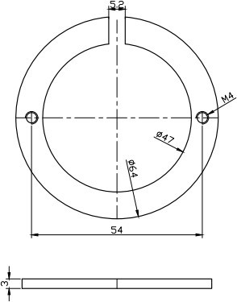
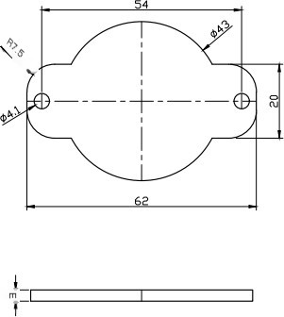
(3) There is basically no blind area. For wall thickness blind area values, if the thickness exceeds 6mm, please provide the material and accurate wall thickness. The minimum blind area value can be reset for shipment;
(4) Long-term stocking for RS232 and RS485 interfaces, with voltage and current analog output
Please make a reservation in advance. It is recommended that the RS232 transmission distance be less than 10m. If the communication distance exceeds 10m
Please choose RS485.
Product size image
22mm
40mm
980mm
35mm
42mm
Default with 3/6m cable optional
Mounting bracket size

Slide 5

2/10
Data frame structure
*XD, angle, ID number, liquid level, real-time value, signal quality, fixed value, check code#
name
value range
Instructions
Head code
*XD
-
angle
0000-
0090
Unit: hour
ID number
00-nn
Any two characters
liquid level value
0000-
9999
Unit: 1mm
real-time value
0000-
9999
Unit: 1mm
Signal quality
quantity
0000-
0039
-
fixed value
0300
0300
checksum
0000-
9999
-
End code
#
-
Head code
*XD
Degree (or angle)
0002
ID number
01
liquid level value
0038
real-time value
0038
Signal quality
quantity
0039
fixed value
0300
Inspection and
1371
End code
#
The data format of the frame is: *XD,0002,01, 0038,0038,0000,0300,1371# The bytes for the checksum are sum=rx[4]+
rx[5]+…+rx[30]+rx[31]
Default protocol (Universal protocol for fuel rod and fuel quantity)
(1) Set the liquid level sensor ID (multiple sensors, using 485/232 communication ID by default)
Think 01)
The command sent from the terminal or computer to the liquid level meter is ASCII: $!ID0133
The ID is "command01" and is the ID value
hexadecimal
:24214944303133330D0A
Reply from the liquid level meter:
ASCII:
*SID01OKOKOK39
Indicate success.

Slide 6
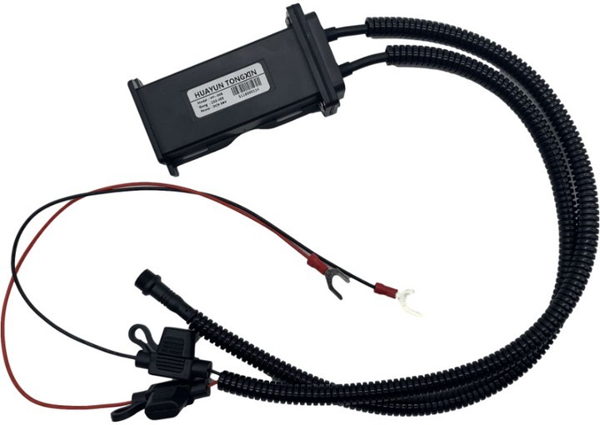

*SID01NONONO42
Indicating failure.
01 represents the set ID value, OKOKOK indicates successful setting, and ONONON indicates failed setting.
Hexadecimal:
2A 53 49 44 30 31 4F 4B 4F 4B 4F
4B 33 39 0D 0A
2A 53 49 44 30 31 4E 4F 4E 4F 4E 4F 34 32
0D 0A
(2) Read liquid level filtered digital value (recommended as a command for GPS device reading): Command sent from the terminal or computer to the oil level gauge:
ASCII:$!RY0151
Hexadecimal: 24 21 52 59 30 31 35 31 0D 0A
Oil level gauge reply:
ASCII:*CFV0100FA32B6
Protocol explanation: *CFV is the protocol output; 01 is the return address bit; 00FA32 is the current AD value, with 00 representing padding of less than 6 bytes, and FA32 representing the current fuel level
The hexadecimal representation of the ASCII value of AD, which indicates that the current oil level value is 0xFA32;
B6 is for parity check.
Liquid level conversion: *CFV0100FA32B6: 00FA32 (hexadecimal) =
64050 (decimal)
-> 64050/ 65535*1000≈977.3mm
Note: This AD value corresponds to the change of oil level from 0% to 100%
AD values from 000000 to 00FFFF
Hexadecimal: 2A 43 46 56 30
31 30 30 46 41 33 32
42 36 0D 0A
The host supports command issuance

Slide 7
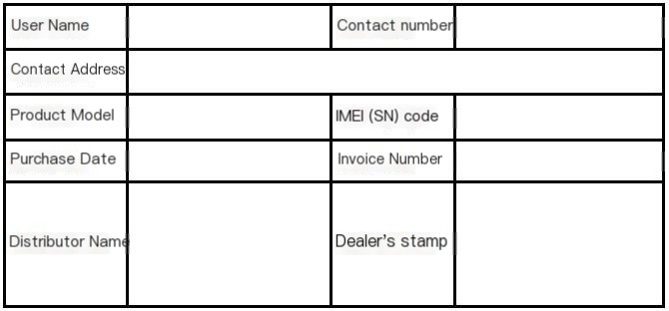
Packing List
serial number
1
2
3
name
sensor
Double-bolt fixed bracket
extension cord
quantity
1
1
1
unit
a
A clause
purpose
Fixed sensor 3 meters or 6 meters
Remarks
Comes with a sealing ring
Tighten the upper and lower nuts to secure the large terminal
Installation accessories
1
2
4
6
7
8
wrench
Kraft AB glue
Install Kraft sandpaper
Wiping paper towel
cable tie
1
1
1
1
1
5
a
box
Support and Expansion
"Xiaobao"
Tighten the bracket screws
solid
Paste and fix the bracket
Coupling during sensor installation
Polish the fuel tank
Clean the bottom of the fuel tank
Fixed cable
bring your own
Mix evenly at a ratio of 1:1
It is recommended to apply a full coat of sealant inside the sealing ring, and it is advisable to bring your own
It is recommended to bring your own suggestions
Liquid level reading tool
1
display board
/
a
Test installation and reading
Get liquid level
optional
Complete set of products: Gross weight 0.4Kg, packaging dimensions: 22.5cm x 14.2cm x H6.2cm. Outer box weight: Gross weight 12.3Kg, outer box dimensions:
50cm x 36cm x H30cm, quantity per full carton: 20 sets/carton
After-sales warranty card

Slide 8

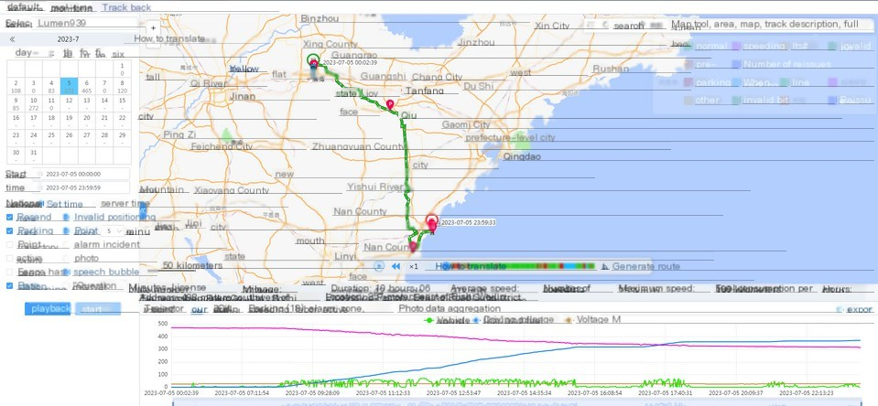
Manufacturer:
Company headquarters:
production base
Company website:
Certificate of Conformity
Contact Information
This product has been inspected and approved for shipment
Product model: _________
Inspector: __________
Manufacturing date: _________
Platform Features
Record daily mileage, fuel consumption, driving trajectory, monitor changes in fuel tank level, automatically calculate startup working hours, summarize monthly working hours, and also monitor idle time, idle fuel consumption, and idle fuel consumption. Statistics of abnormal behaviors such as speeding and fatigue driving
Accurately record refueling times, generate graphical and textual reports, and tally monthly and daily fuel consumption and usage, while documenting refueling locations. Prevent drivers from concealing refueling locations, fuel quality, and fuel quantity. During use, if someone extracts fuel from the tank, the platform will trigger an alarm, generate a report, and record the time and location
130711 | 100 liters
130715
130718 |  | 58 liters

Slide 9
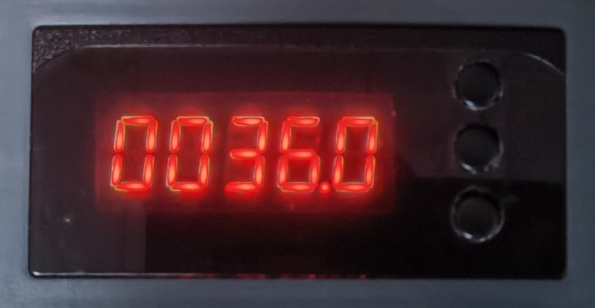
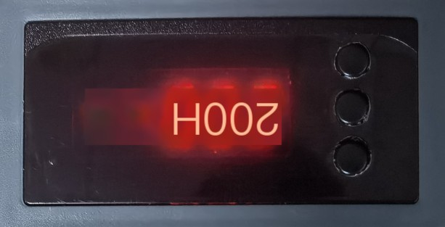
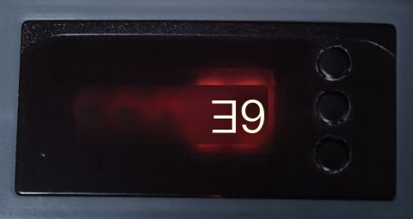
Installation method
project
Prepare the product
Prepare the tool installation location
Instructions
For details of the host sensor, please refer to the packaging specification
Read the handle, 8-hole wrench, pliers, etc., dirty fuel tank with polishing machine
The vehicle needs to be parked in a stable place
Remarks
All inspections are complete
"Be sure to bring a flat surface."
Note: Ensure the vehicle is parked steadily. Inspect the tools before installation. If possible, test the device sensors upon receipt
Display board usage
function
Instructions
Remarks
Reading a liquid level height of 36 indicates 36mm
Press the two buttons below to turn pages
function
Instructions
Remarks
Read the installation angle. Be careful not to exceed 5 degrees
If the value is greater than 5, long press the top button for three seconds to calibrate
function
Instructions
Remarks
Read the echo quality of the installed sensor, which is at 39 full value
If it is below 20, press and hold the top button for three seconds to calibrate

Slide 10

Installation Process
Received device for testing
The vehicle is parked level
Find the right position for the fuel tank
Install the reading handle
Apply mounting silicone
Read controller data
AB glue fixed bracket
Apply silicone to the screws
Conform to inspection data
Horizontal angle: The vehicle is parked level, with the fuel tank's horizontal inclination angle being less than 4 degrees
rear of the car
Recommended installation
front of the vehicle
yellow zone
Oil level: There should be some inside
An oil level of about 10cm is ideal for installation
Support installation in the lower area
Keep the area clear and avoid obstacles
Avoidable areas: oil pump, oil float
Obstacles such as the son, heating tube, oil tank partition, and oil rod
The tank body is horizontal, and the sensor is installed horizontally
correct
Installation area: The installation point should be as close as possible to the middle of the bottom of the fuel tank
The surface of the tank is uneven
error
Tank body or sensor tilting tank body arc, sensor horizontal tank body arc, sensor tilting
error
Installation surface: Ensure it is flat, with any paint, rust, or coating removed through grinding. Clean any dirt or oil stains to guarantee that the AB glue on the bracket does not fall off.
correct
error
9/10

Slide 11

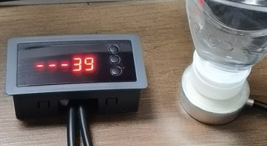
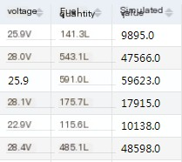
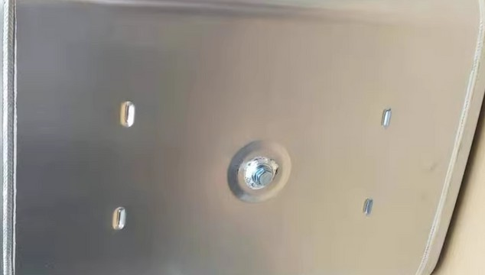
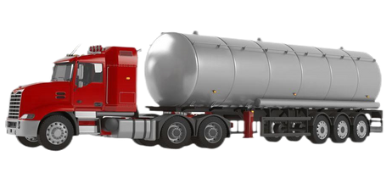
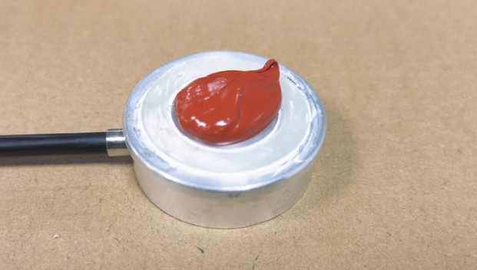
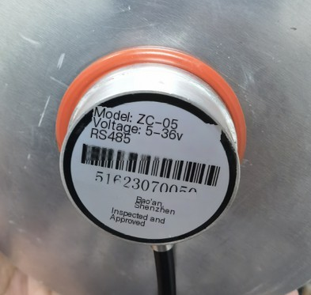
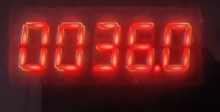
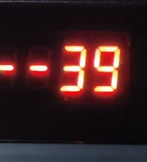
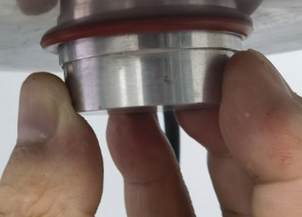

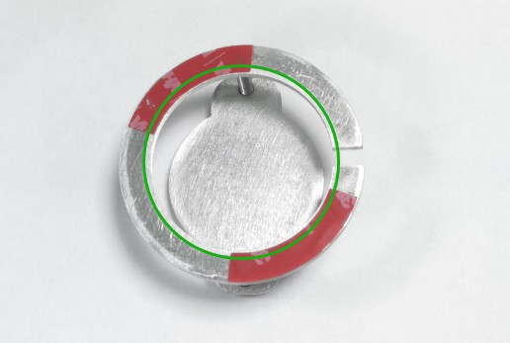
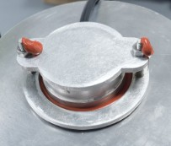

Installation example
After receiving the product, power on the device first
Plug in the reading handle and familiarize yourself with the process
Put a mineral water bottle with some water added in the middle, read the data and ensure it is normal. Then connect to the host to check the platform's analog data. If everything is normal, proceed with installation.
Selection of installation location at the bottom of the fuel tank
Clean up the area above and ensure it is free of debris. Spread it out evenly and pay strict attention to avoiding obstacles inside the fuel tank
The tank body of the vehicle is placed flat
Apply coupling silicone, use the same amount as shown in the picture, and clean up
It must be clean, without any air or water stains
Press firmly on the pre-installed position of the fuel tank, ensuring that the anti-slip rubber ring on the top fits tightly around the tank, with a slight overflow as shown in the picture
View the display panel to read data information
Refer to the instructions for using the display board
If the data is normal, do not touch the sensor
"There is no data. Press the rotation sensor to check the data. If there is still no data, try installing it in another position."
Do not apply AB to the green areas and where 3M adhesive is used
Apply AB glue to other areas of the bracket. It can be cured in 5 minutes in hot weather, but you may need to wait longer in cold weather
Gently bypass the cables sticking to the tank wall and press it into place. Check the status of the reading board
If the sensor is not pressed properly, apply a small amount of AB glue around it to prevent it from falling off after it becomes normal
Do not use AB glue for plastic fuel tanks. Instead, use red Kraft silicone adhesive
1. After securing the bracket, observe the display panel data, and pay attention to securing the 1-meter cable that comes with the ultrasonic device to prevent it from swaying and affecting the installation.
2. Then, remove the display board and dock it with the host. After two minutes, observe the platform's analog quantity. If everything is normal, check the bonding tightness. This completes the installation. It is worth noting that after installation, it is recommended not to drive the vehicle immediately to prevent the vibration support from falling off. The screws should not be too tight; just tighten them enough to install and apply glue.
Friendly reminder: You can install the bracket first after you become proficient
10/10

